Slide 1
PET – A - PET
Esther Emmanuel , Daffinia F , Swathi P , Hernisha Antony ,
Jaziz Jerusha Paulin

Slide 2

jhbhb
WHAT
WE
DID?
W
H
Y
?
AS
A
RESULT
W H A T ?
H O W ?
W H A T W E U S E D ?
C O N C L U S I O N

Slide 3


W H A T ?

Slide 4
W H A T ?
A system that can take care of your pet and feed it while you are away.

Slide 5
W H Y ?

Slide 6
W H Y ?
The inability to care of a pet when a person is unavailable to stay with it and feed it from time-to-time.

Slide 7
H O W ?

Slide 8
H O W ?
It is done by checking if the pet is somewhere around it’s feeding bowl. The information collected by the sensor is transmitted to the user. This allows him to operate the motor that is programmed to fill the bowl with pet food whenever needed.

Slide 9
W H A T W E D I D ?

Slide 10
W H A T W E D I D ?
ULTRASONIC SENSOR
WEB PAGE
ESP32
POWER SUPPLY
SERVO MOTOR
BUZZER

Slide 11
W H A T W E U S E D ?

Slide 12
W H A T W E U S E D ?
H/W
ESP32
S/W
ARDUINO UNO
WEB PAGE
SERVO MOTOR
ULTRASONIC SENSOR
BUZZER

Slide 13
A S A R E S U L T ,

Slide 14
A S A R E S U L T ,
Pet-a-pet helps us to feed a pet from anywhere at anytime at the click of a button by anyone who is concerned.

Slide 15
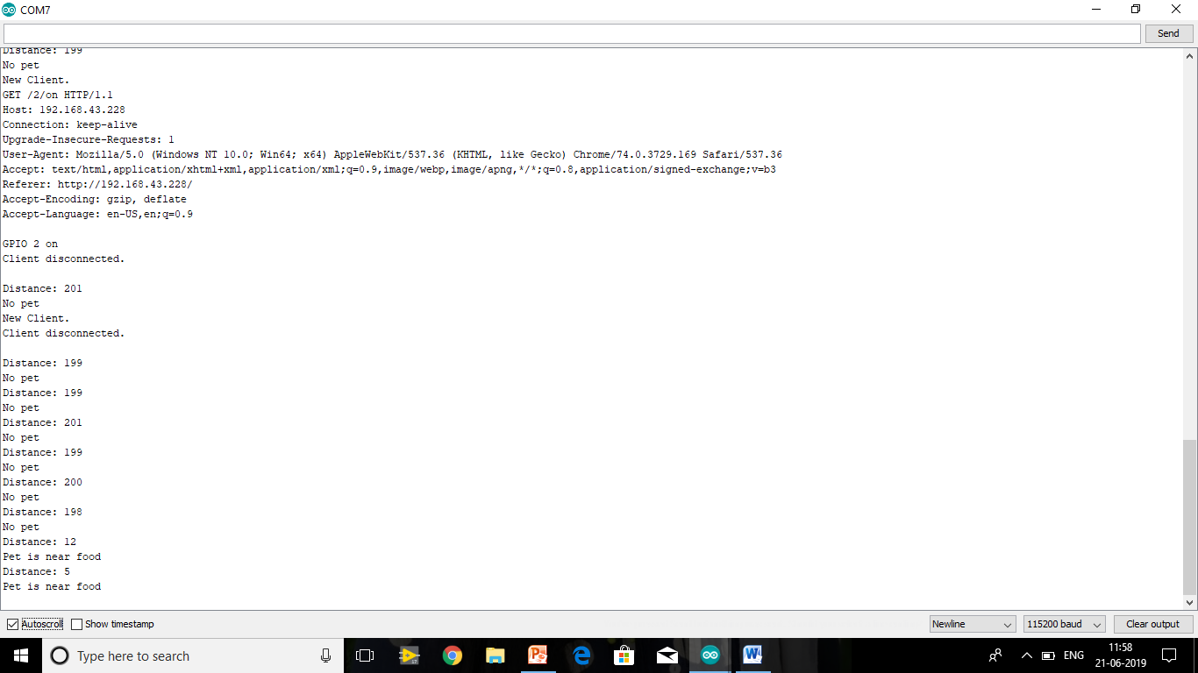

Slide 16
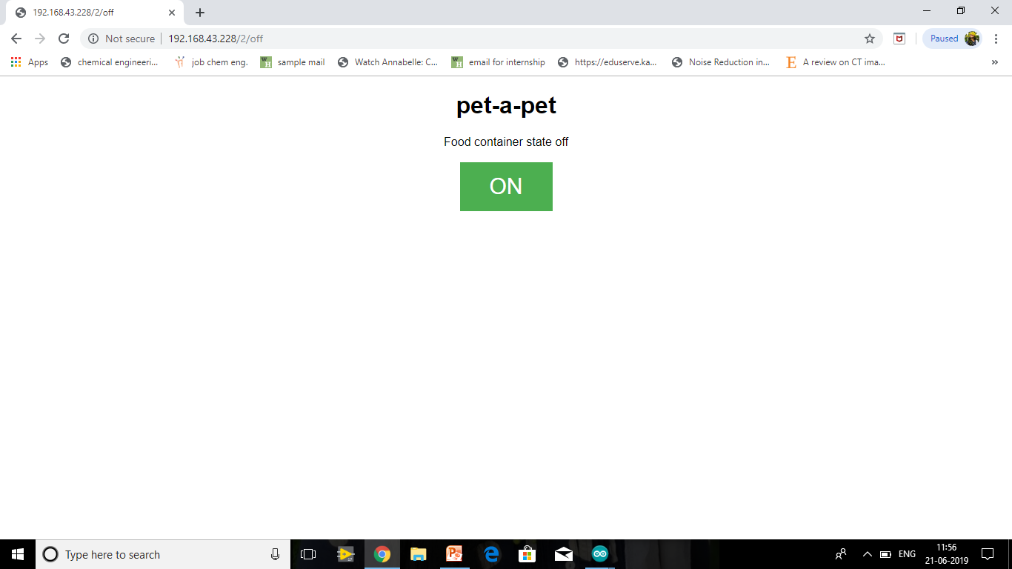

Slide 17
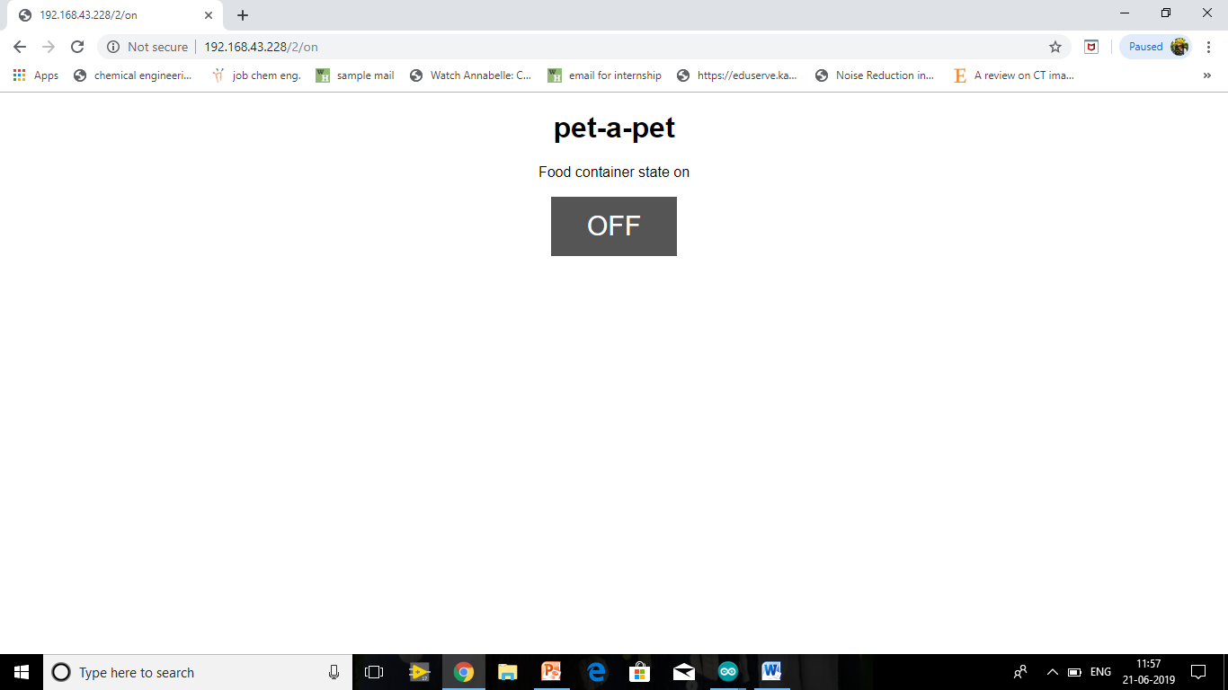

Slide 18
T H A N K Y O U

